Slide 1
port of Marseille Fos
A SMART PORT FOR ENVIRONMENTAL EXCELLENCE
13th European Biennial of Towns and Town Planners 2019
13 September 2019
Frédéric DAGNET – Port of Marseille Authority

Slide 2
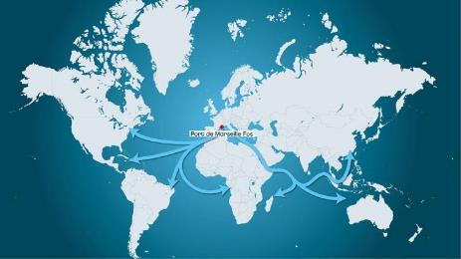
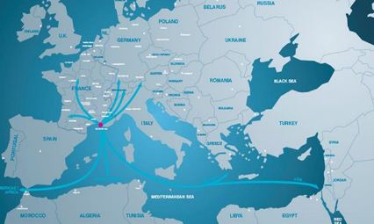
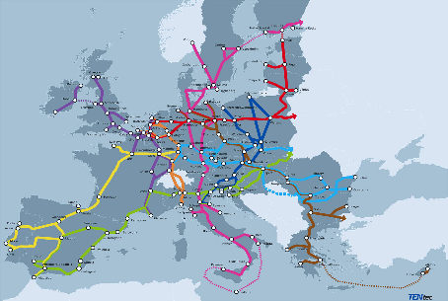



Mediterranean Strategic Hub
East / West Road
North / South Road
Corridor North Sea – Mediterranean Sea
Corridor Mediterranean Sea
400
ports connected
7500
Calls
1st French Port
1st Med Market Port
6th European Port

Slide 3
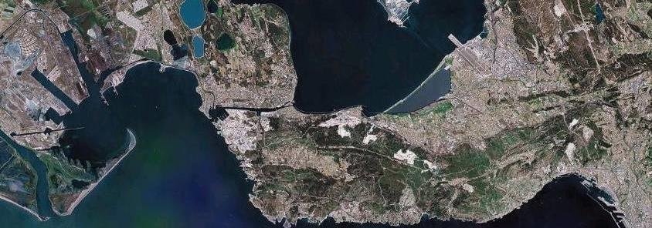
Marseille Fos a multipurpose port
One port, two harbors
INTERNATIONAL
AIRPORT MARSEILLE PROVENCE
FOS
10.000 Ha
MARSEILLE
400 Ha

Slide 4
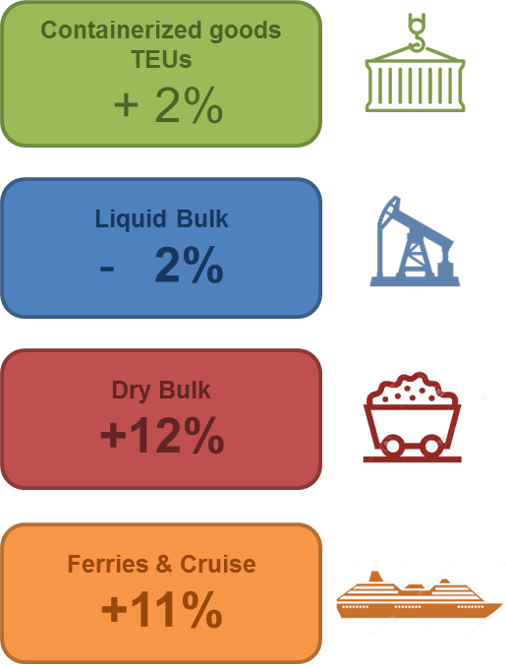
Marseille Fos 2018 vs 2017
TEUs
1, 4 M
Dry bulk
14 MT
Passengers
2,9 M Pax
Liquid
Bulk
47 MT
81 MT
+45,000 port-related jobs
3.5 billion euros of added value

Slide 5
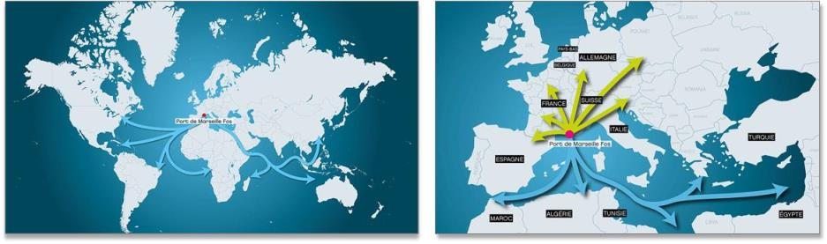
Strategic hub in the Mediterranean
5
East/West flows
East-West Trades
North-South Trades
The Southern Gateway to Europe

Slide 6
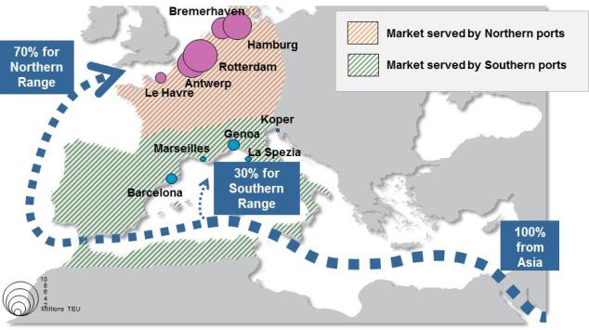
Marseille Fos: The Southern Gateway for Europe
The Mediterranean alternative

Slide 7
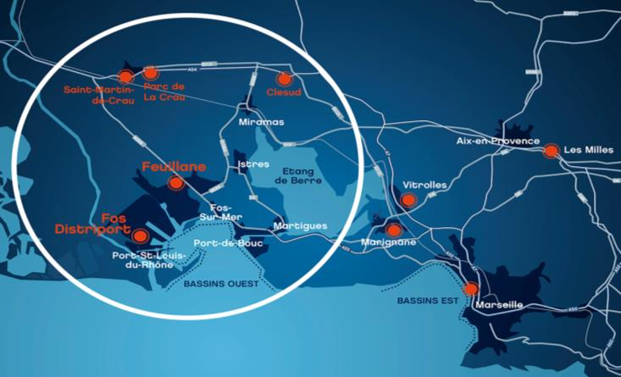
The port of Marseille Fos
Main logistics plateforms
3 millions m² of
Warehouses 50 km
around Marseille Fos

Slide 8





























A favorable position for logistics
Shippers and logistics trust in Fos
LOGIFOS

Slide 9
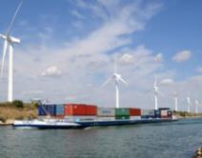
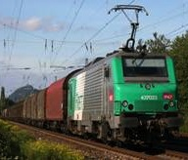
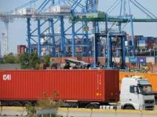
Multimodal port – trimodal connectivity
6%
11%
Multimodal options for inland transportation, modal shares:
River network : 6%
Rail network : 11%
Highway network : 83%
83%

Slide 10

Marseille Fos : a multimodal Network
Fast expansion of regular rail services
25 destinations in France & Europe
Chavornay – Rotterdam – Antwerp – Zeebrugge –
Ludwigshafen – Duisburg – Hamburg – Lubeck – Munich – Rotterdam Schkopau - Buna-Werke

Slide 11
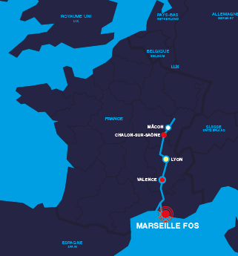

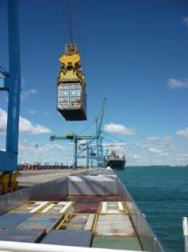




Marseille Fos : a multimodal Network
Growth of River traffic
5 SERVICES PER WEEK: Fos - Valence - Lyon

Slide 12

Green Port and Blue Economy
PORT OF MARSEILLE FOS’ MASTER PLAN 2019-2023
→ Combining environmental excellence and competitiveness for a better attractiveness

Slide 13




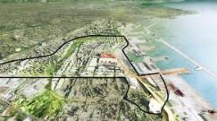
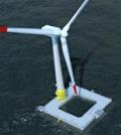
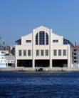
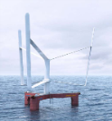
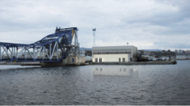





















A collaborative action initiated by
Supported by
With major companies

Slide 14







A fluent port
A green port
A positive energy port
An innovative and job-creating port
3 Issues / 4 Operational Aims
Intelligent & efficient logistic
Industrial & energy excellence to improve environmental efficiency
Best-in-class digital offer

Slide 15

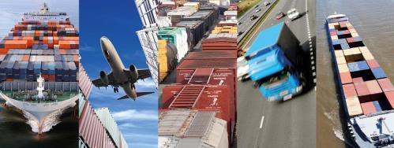

The CCS connects up all entire supply chain with smart door-to-door goods tracking
FastLane
Interoperability
Activity Monitoring
Business intelligence
User centric
Notes:
Regarding the goods tracking, the Cargo Community Systems Ci5 relies on web technologies to connect up all entire supply chain.
The new release of Ci5 will be commissioning in 2018

Slide 16

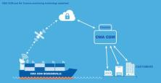
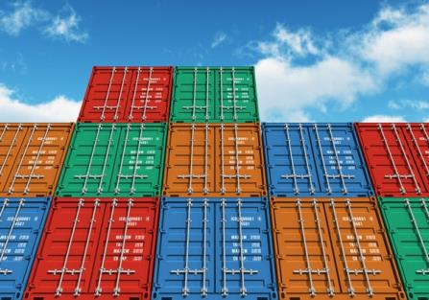

Integrated Intelligent Multimodal Transport
A Tool for Optimal Coordination Of Cargo & Equipment
Notes:
Another innovative logistics system has been developed by a local startup company in order to track the containers with RFID chips.
TRAXENS is now a subsidiary of CMA CGM and they are developing the IoT in logistics for top 3 companies in the container industry, like MSC

Slide 17
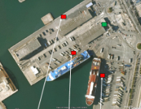
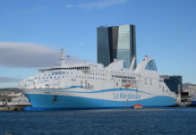
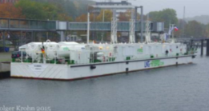
Shore-to-ship power
Marseille 1st Mediterranean Port to plug ships onshore
In progress for shiprepair and cruise: A 20M€ investment plan to 2025
Notes:
Always in the field of energy, Marseille 1st Mediterranean Port to plug ships onshore
Experimentation for 3 passengers ships
Ships can shut down their engines while berthed and plug into an onshore power source
Emissions to the local surroundings are eliminated.
This will become an obligation for 2025 regarding sulfur emissions
This offer is in progress for cruise megaships and shiprepair also

Slide 18
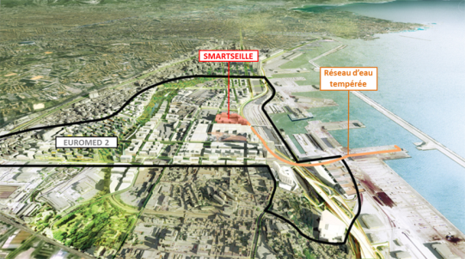

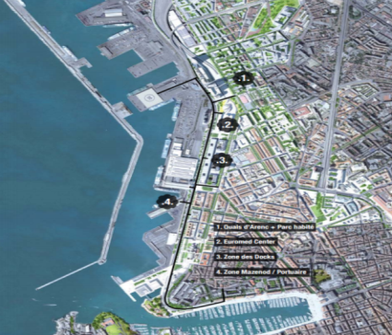

Marine geothermal energy
2 power plants providing heating, hot water, air conditioning
EDF
Thassalia
Notes:
In Marseille, ENGIE and EDF are developing the first French marine geothermal energy power plants.
They are providing heating, hot water and air conditioning for several buildings in the Euroméditerranée district.
The source of this energy grid is the water pumped into the harbor basins.

Slide 19
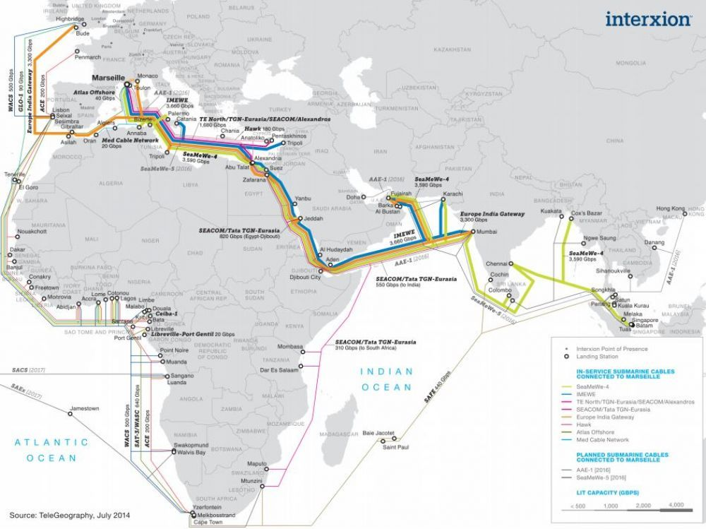
Marseille: Digital hub on Silk « digital » road…

Slide 20
BRAIN PORT COMMUNITY
Investissements
Innovation Ouverte
Accélération de projets
Smart Port Data
Promotion Communication
Brain Port Community
Partnership agreement focused on projects
The Brain Port Community brings together the academic community of the Aix-Marseille metropolitan area to work on mid and long term issues faced by economic partners :
Research and development issues
Training issues

Slide 21
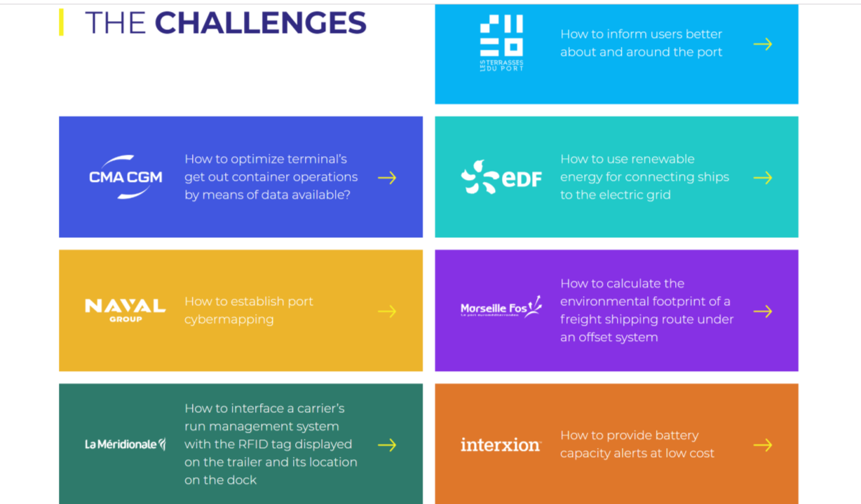
THE SMART PORT CHALLENGE FOR OPEN INNOVATION
Investissements
Innovation Ouverte
Accélération de projets
Smart Port Data
Promotion Communication
Brain Port Community
Go to → www.lefrenchsmartportinmed.com

Slide 22

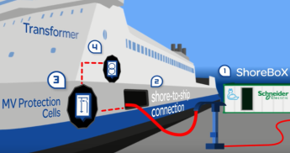
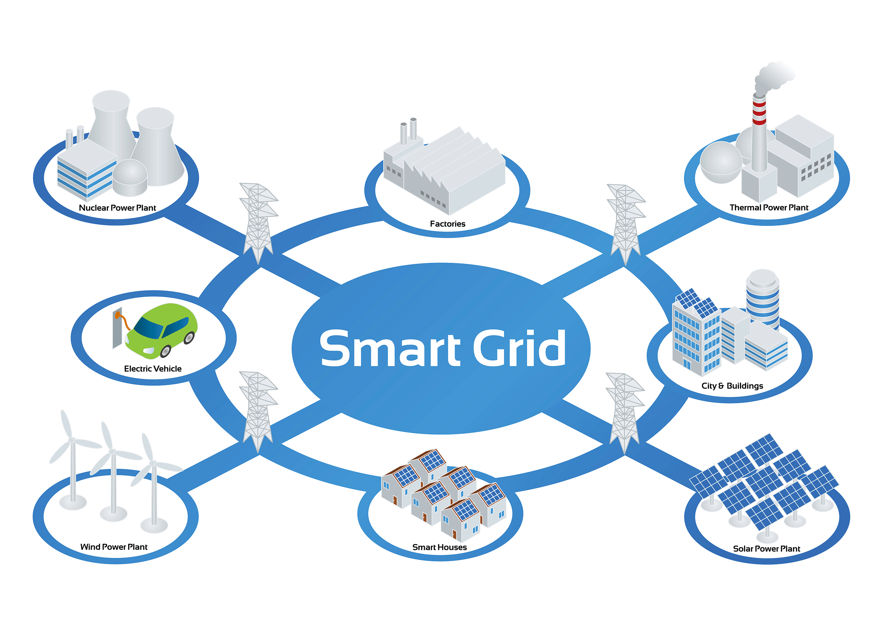
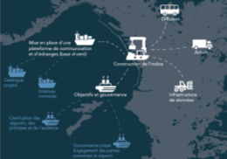






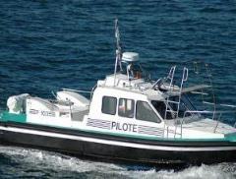
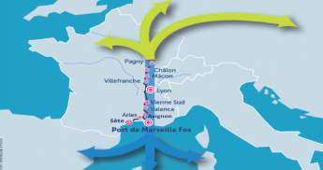









PROJECTS LABELLING
Investissements
Innovation Ouverte
Project labelling
Smart Port Data
Promotion Communication
Brain Port Community
6
Topics
12
Labeled projects
+50
Active partners
Environmental
performance
index
Port Smart Grid
1st pilot boat
about to be implemented
by the pilots of Marseille-Fos
Artificial Intelligence for ports
22
Electric pilot boats
Port Cyber Security
Cross disciplinary degree
Maritime
and port activities

Slide 23









SMART PORT OBJECTIVES & UN SDG’S
A fluent port
A green port
A positive energy port
An innovative and job-creating port

Slide 24
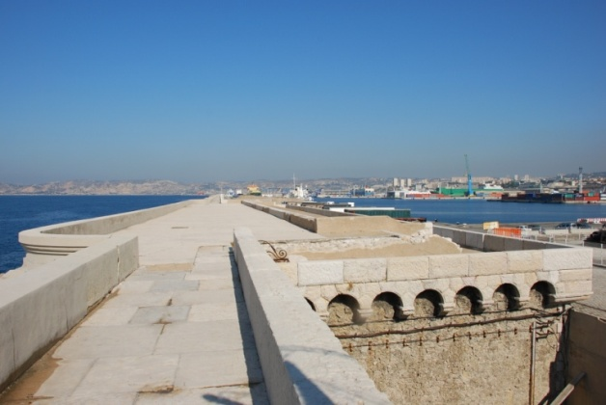
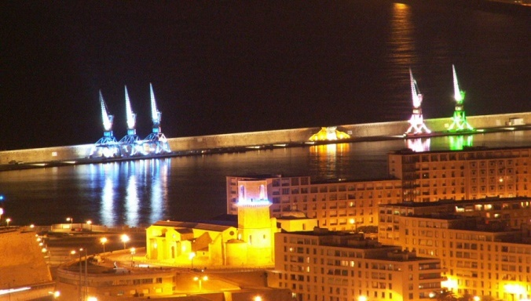

A SMART PORT IS A CITIZEN PORT
« Digue du Large » on historical dyke
Built in 1852
The fishermen have a special authorization
Maritime visit shuttle of the harbor
The Port of Marseille was partner of Marseille Provence 2013 European culture capital

Slide 25
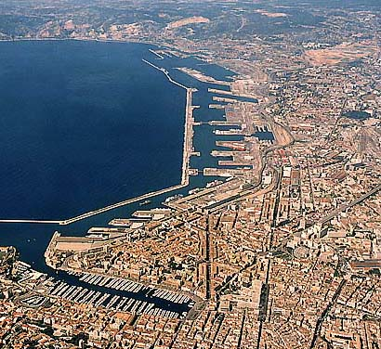
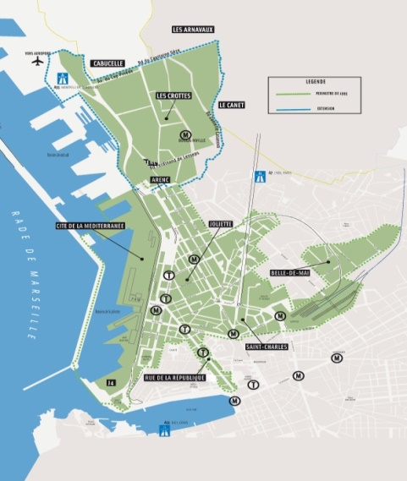
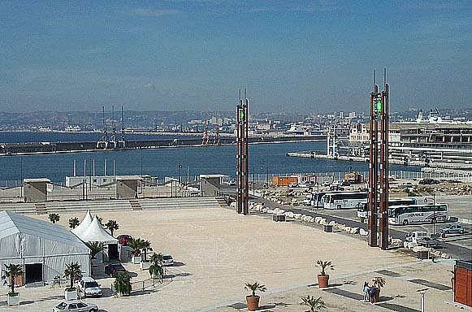
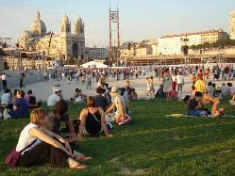

A SMART PORT IS A CITIZEN PORT
New CITY-PORT interface : The Port & Euroméditerranée
20 YEARS OF COLLABORATION
A close collaboration with « Euroméditerranée »
Planning of projects close to the population around the port
J4 : This old harbour shed is became public place

Slide 26
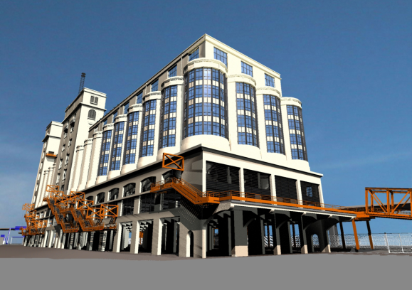
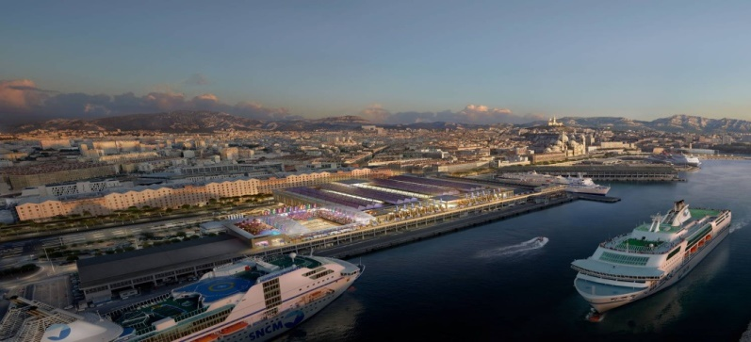
A SMART PORT IS A CITIZEN PORT
“SILO” : renovation and change a former silo into a modern concert hall and business centre (while keeping the ground floor as the way in for ferry passengers)
“TERRASSES DU PORT” : construction of a huge shopping complex on the upper deck of the Port facilities (while preserving the ground floor for operations)

Slide 27
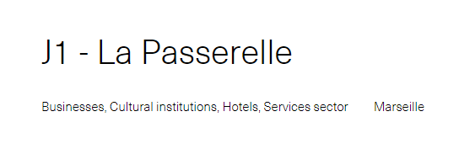
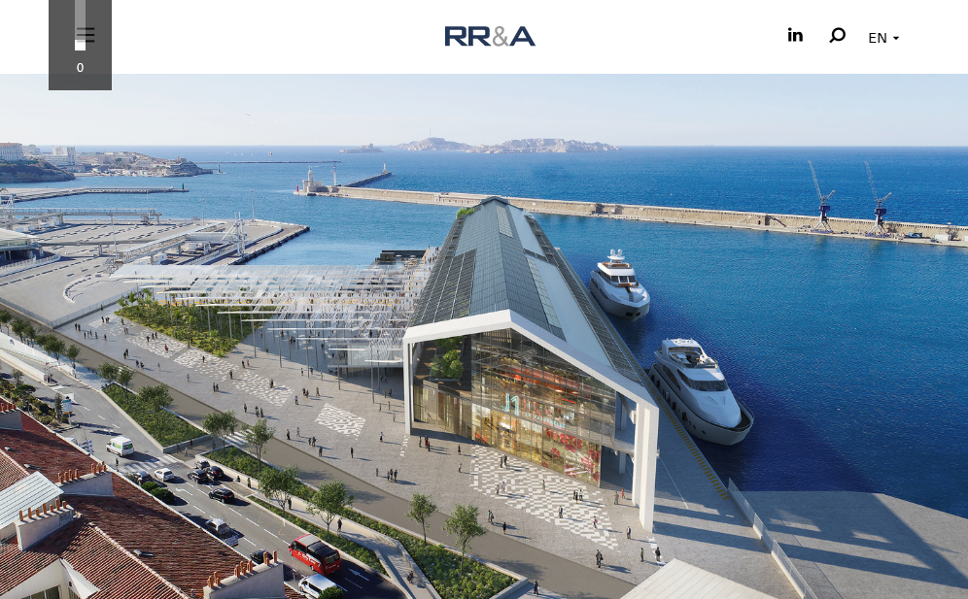
A SMART PORT IS A CITIZEN PORT

Slide 28
Thank you for your attention

