Slide 1
Marine Spatial Planning
ECTP Biennial Conference
Plymouth
11-13 September 2019

Slide 2
Marine Spatial Planning
Approaches to Marine Planning:
Assessment of the progress and effectiveness of marine planning-reflections for the Blue Economy
Anne-Michelle Slater, University of Aberdeen
Jim Claydon, Planning Consultant

Slide 3
Overview
Review: Marine Plans in the UK
Context implementation theory
Marine licensing decisions
Exploration of use of policies in shaping marine licensing decisions - focus on Blue Economy
Findings and Reflections

Slide 4
Plans Resulting from the MCAA
England: regional plans (inshore and offshore)
  East: adopted 2014
  South: adopted 2018
Scotland’s National Marine Plan (2015) - Reviewed 2018
Welsh National Marine Plan: public consultation 17-18,
Marine Plan for Northern Ireland: public consultation 2018

Slide 5
Regional Plans
England: North East, North West, South West, South East - All progressing concurrently - Public consultation later in 2019
No regional plans proposed for Northern Ireland or Wales
Eleven Scottish Marine regions : Marine Planning Partnerships
  Shetland
  Clyde
  Pentland Firth and Orkney Waters Marine Spatial Plan (non statutory)

Slide 6
Economic Imperative (Background to 2009 MCAA)
Marine Renewable Energy and other economic pressures around the UK coasts; eg cabling
2008 Planning Act – Nationally Significant Infrastructure (offshore wind & tidal energy, ports, nuclear, carbon capture and storage) in England and Wales (terrestrial & marine)
Scotland – Aquaculture, planning powers of LAs extended to cover shell & finfish farming inshore
Complementing environmental and social imperatives
Comparable pressures in other jurisdictions

Slide 7
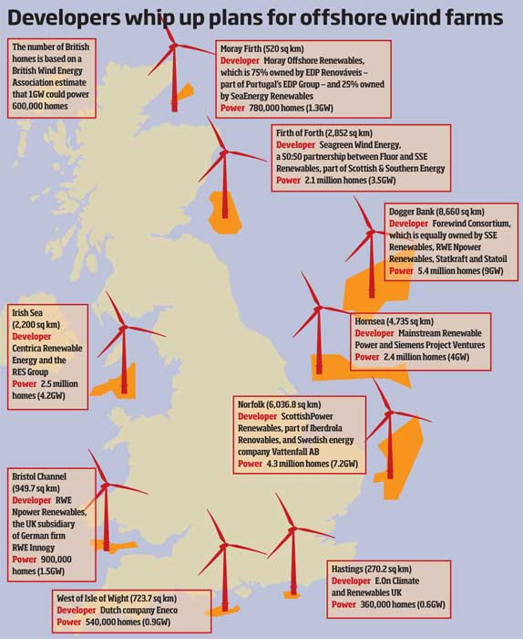
Offshore Wind Farms in UK
33 OWF in operation, 3 under construction, 12 with consent
Of those operational 2,016 turbs, 8,483 MW capacity, 4.2MW ave/turb
Walney Extension (E+W) - 87 Turbs, 659MW,
7.5 MW ave/turb
Of those consented & under-construction 1639 turbs, 15,024MW, 9.2 MW ave/turb
DoggerBank/Sofia (2) –500 turbs, 5,000MW, 10.0 MW ave/turb
Source – Renewable UK & Planning Portal

Slide 8
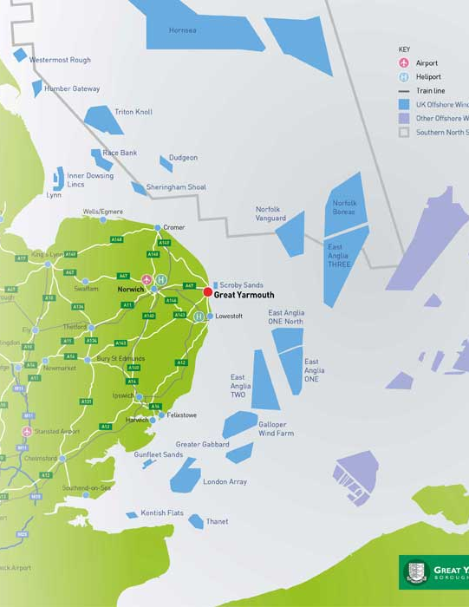
Offshore Renewables (PINS)
(In England& Wales since 2013 - subject to NSIP Process where NPS is pre-eminent)
Applications notified
21 OSW+ (4 Tidal Lagoons)
5+(3) pre-app/exam
15+(1) permitted
1+(0) refused
Source - PINS
Source – Gt Yarmouth DC

Slide 9
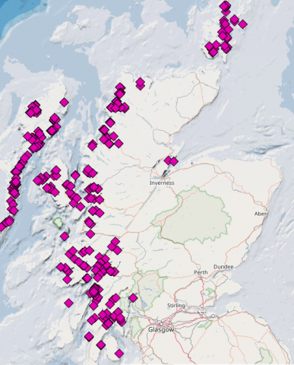
Aquaculture in Scotland ( Farmed Atlantic Salmon)
Scotland largest EU producer
Top 3: worldwide
  Norway
  Chile
2016: 162 817 tonnes
Top food export for Scotland
2020 Industry target: 210 000 tonnes
Sustainable growth supported by Scotland’s Marine Plan (2015)

Slide 10
Implementation of marine plan policy in UK
Section 58 MCAA
Requires that all public authorities take authorisation or enforcement decisions in accordance with marine plans , unless relevant considerations indicate otherwise
Not a mandatory requirement to ‘slavishly’ follow the plan; a plan led system allowing discretion
Consideration of the relevant marine plan be in parallel with the existing application requirements, including Environmental Impact Assessments and Habitats Regulation Assessments
Plan policies may be general or sector specific

Slide 11
Renewable Energy and Aquaculture policy implementation –
A comparison with Norway
Hierarchy of plans
Flexibility in implementation
Licensing process: provides detail and focus in individual cases
Norwegian Aquaculture example
Role of policy:
  Integrated management plans for large eco marine regions
  Norwegian aquaculture production zones
  Southern Hordaland and Western Hardanger: Regional Coastal Plan ( non binding)
  Municipal plans (Land and 1nm beyond base line) link with licence
As in Scotland, Norway developed existing system to address new issues aiming for predictability and adaptability (of which marine planning a key part)

Slide 12
Research Question
Have the plan policies made a difference to decisions on marine licensing?
  How are marine policies taken into account in decisions; by applicants; by licensing team?
  What use is made of policies in decisions/recommendations?
  What role does policy play in conditions?
Terrestrial Lens

Slide 13
Implementation theory
Producing plans with policies assumes a ‘top down’ understanding of implementation (Sabatier& Mazmanian 1980)
Policies direct the decisions of implementers (consenting authorities)
Drawing on
  Per Nilsen (2015) ‘Making Sense of implementation theories, models and frameworks’ , Implementation Science
  Mark C. Smith (2018) ‘Revisiting implementation theory: An interdisciplinary comparison between urban planning and healthcare implementation research’ Environment and Planning C

Slide 14
Our application of implementation theory
Requires:
  Clear unambiguous policies
  Sound understanding (theory) of how the policies will work to achieve the plan objectives
  Strong legal/ administrative structure to ensure compliance
Our study considers whether these prerequisites are met by the U.K. marine plans
Concludes that a ‘bottom up’ understanding of policy implementation (Barrett and Fudge 1981) required to explain the marine planning outcomes

Slide 16
Method
Review of the UK Marine Policy Statement, Scotland’s National Marine Plan and regional marine plans in England.
Review of decisions
Qualitative, semi-structured interviews with key decision makers from marine licensing bodies in England and Scotland and representative of developers
Conducted over 2018/19

Slide 17
Initial Findings of Research Project
Policies written in general terms and lack spatial or quantitative specificity
Limited understanding of how the policies achieve marine plan objectives
Legal and administrative structures being subverted by implementers with a more negotiative approach

Slide 18
Further Findings of Research
Supportive policies lack direction and spatial specificity e.g. Proposals that “encourage”
Sectoral policies in plans vague/bland e.g. “sustainable , diverse, competitive, economically viable”
Policies reliant on lower level documents e.g. Marine Scotland Consenting and Licensing Guidance for Offshore Wind …Energy (2018)
Few refusals and no appeals
Conditions influenced by policy but not explicit in decisions

Slide 19
Conclusions to Research
Organisational disconnect between policy makers and licensing officers in plan making and decision making
Lack of specificity/rigour in the policies
Greater precision in some sectors than others
Culture of decision making (among licensing officers) inclined to conciliation
Absence of political input to the process of marine decision-making

Slide 20
Reflections on effectiveness of marine planning
Marine Plans proved more complex to develop: data collection and engagement with stakeholders
Diverse approaches among the different U.K. administrations allowed learning and comparisons but still in infancy
English sequential regional approach allows for learning from previous plans but raises consistency difficulties
Marine plan policies would benefit from legal challenge during adoption and in application
Establishing first round of plans has released a new forward-looking comprehension of our seas and their future. This is perhaps the greatest achievement of U.K. marine planning so far.

Slide 21
Anne-Michelle Slater
School of Law
University of Aberdeen
a.m.slater@abdn.ac.uk
+44(0)1224272427
Jim Claydon
Planning Consultant
jim@jimclaydon.co.uk

