Slide 1
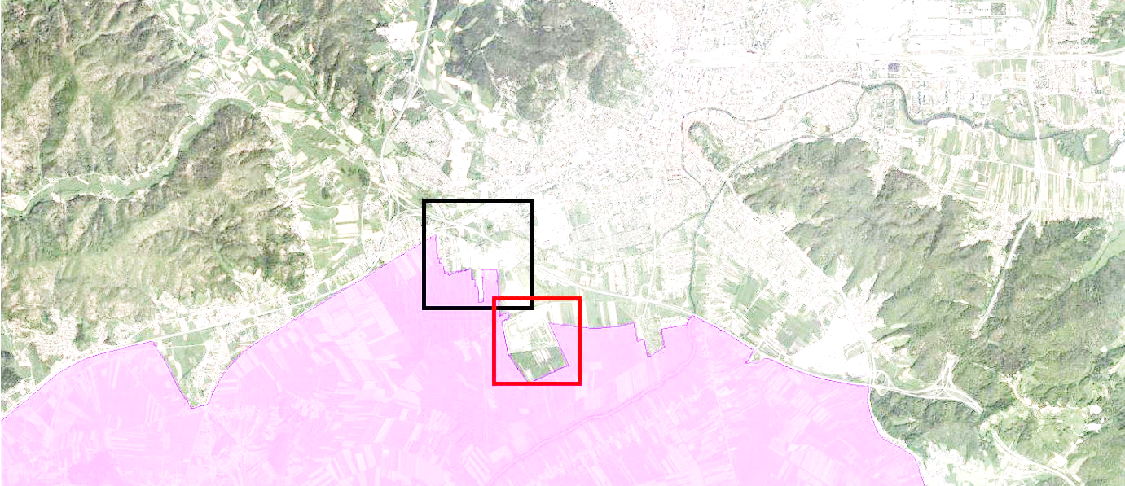
Evaluation of the rural-urban fringes as a tool for spatial planning:
Case study in Ljubljana, Slovenia
Barbara Kostanjšek
Ph.D student, University of Ljubljana, Biotechnical Faculty, Department of Landscape Architecture
E-mail: barbara.kostanjsek@bf.uni-lj.si
Phone: +386 1 320 30 78

Slide 2
Introduction
RUF (rural-urban fringes) under pressure of greenfield investments
EIAs lack considerations of visual impacts
(Ir)relevance of existing assessment models
Identity and role of the RUL is at risk
Aim of the research:
Evaluation of the Ljubljana Vič economic zone’s visual impact by in situ method
Verification
- whether (and to what extent) the visual impact assessment (VIA) can improve current spatial planning models
- relevance of current management and protection models

Slide 3
Context
RUF under pressure – „apart from foreign market forces, a result of weak or unadequate spatial planning and subsidies for land consumption“ (Colsaet, Laurans and Levrel, 2018).
Collapse of urban centers, outflow of commercial functions, sealing soils
Placement of economic zones is inadequately regulated on the municipal level – in Slovenia, Czech Republic
Slovenian Spatial Planning Act (2017):
- only regulates retail areas >5000m² and economic zones >10ha
- vulnerability studies, visual impact assessments, other studies are not mandatory
Policy regulations lack direct measures for mitigation/prevention of visual degradation due to the size, shape, material, location or number of interventions

Slide 4
Subject background
Methodology is lacking! to determine visual impacts of spatial interventions, which is the cause EIAs are:
- prepared in different, non-uniform, comprehensible ways
- not using the tools to provide adequate evaluations
- directly and uncritically summing up spatial information
Establishment of economic zones subjected to:
- liberalist concept of spatial planning
- the economy
Tendency towards continuation of:
- structural transformation of industrial zones to economic zones
- further greenfield development
Protected areas are at risk – in this case, the wetlands of the Landscape park
- no special attention is given to the visual impacts on the area (or other protected areas in the country)

Slide 5
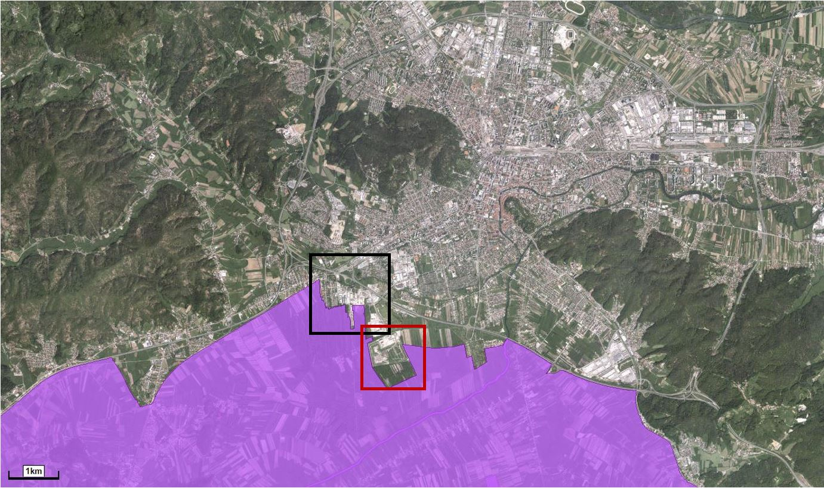
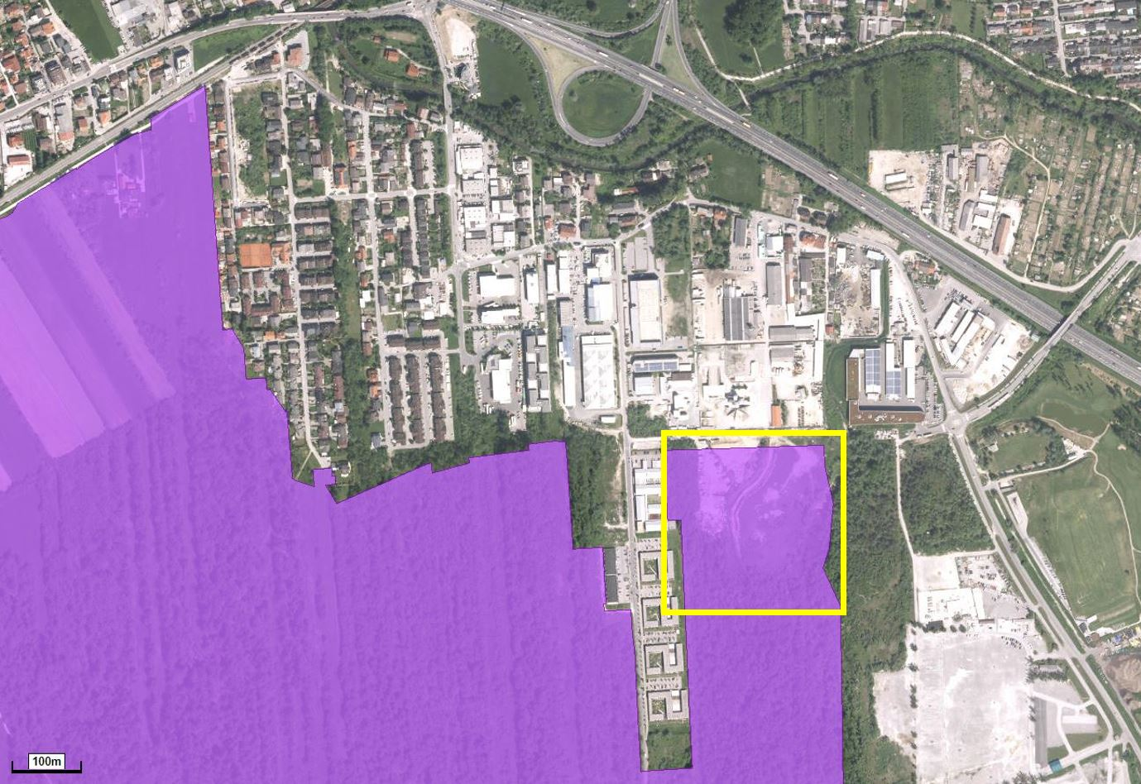
Study area
The Ljubljana Vič
economic zone in the spatial
context:

Slide 6
Methodology
For the purpose of visual impact assessment the in situ method (Cañas Guerrero, 1995) was adopted
Has not been used on cases in urban-rural landscapes – it was adapted accordingly by reducing the number of attributes and customizing them
Further support from the focus group
of the inhabitants and work commuters
The adapted method takes into account 4 physical attributes, each comprising of 3 variables:
1. Vegetation (cover, diversity, quality)
2. Land use (type, intensity, range)
3. Modifying elements (structure, form, colour)
4. View (extent, distance, visibility of the area)
The degrees of visual degradation (weighted mean) classify the landscapes
into 5 levels of degradation:
high, significant, medium, low, very low

Slide 7
Methodology
Attributes, their variables and values for in situ method

Slide 8
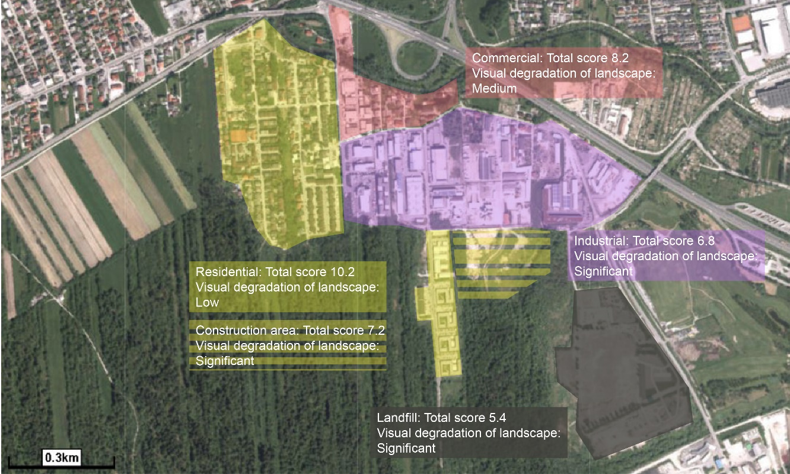
Results and discussion
4 identified types of landscape
(according to dominant use, infrastructure) within the study area:
Landfill – exposed, little and poor vegetation
Industrial area – inadequate forms, large asphalt surfaces
Commercial area – less intensity of land use
Residential – least disturbant

Slide 9
Results and discussion
Visual characteristics of the selected economic zone:
Conventional design, no creative urban solutions
Large buildings in simple shapes
Visibly exposed parking and service spaces
Visual disturbance and other problems exposed within the focus group:
Buildings of the industrial area stand out from the small morphology of the settlement
The entire area is situated next to a Natura 2000 protected site of flood plains
The area is not visually very exposed – shielded with vegetation
From the major roads and settlement the area looks smaller
Highlighted: destruction of agricultural land – placement of economic zones on degraded areas, planning should be in national/regional jurisdiction, appropriate landscape and urban planning measures

Slide 10
Results and discussion
Current spatial planning models can be improved through VIA since it reveals visual deficiencies and impact of economic zones, not represented in the EIA thus not sufficiently supporting environmental protection.
The scope for possible improvements ranges from:
planning phase - within planning documents and relevant studies - prevention
implementation phase or through measures for reducing visual degradation - mitigation
Measures for preventing/reducing visual degradation of urban-rural edges by economic zones:
- brownfield instead of greenfield investments
- reducing visibility of zones: 80% of the edges greened
- structurally diverse, smaller built elements
- greater participation of local inhabitants – workshops, focus groups etc.

Slide 11
Conclusion
The appearance of RUF (notably economic zones) must become subject of more importance and comprehensive treatment
Inclusion and integration of VIAs, visibility studies, visual analyses of landscapes and vulnerability studies into the EIAs, environmental protection policies, supporting documents
Urban planning solutions, design of economic zones – reduction of visible exposure, size of buildings, increase of the share of green areas)
Better design – better reputation of the economic zone, a less pronounced sense of generic space, an improved net use of land
Greater consideration on governance level responsible for strategic planning of areas of economic interest

