Slide 1
Miracle or Disaster:
How Regional Planning outside the Border can influence Local Planning inside the Border?
Vivian Ko & Jeffrey Ng
12 September 2019
13th European biennial of towns and town planners 2019 | planning on the edge

Slide 2
Introduction
Miracle or Disaster:
How Regional Planning outside the Border can influence Local Planning inside the Border?

Slide 3
Regional Planning
Capacity to coordinate different interests at different levels beyond the geographical and spatial context of the administrative areas (Chung, 2015)
Challenge for local authorities when there is a differentiation between a regional planning policy and a local planning policy (Tang & Jin, 2018)

Slide 4
Introduction
Using two mega-infrastructures in Hong Kong as case studies
  Guangzhou-Shenzhen-Hong Kong Express Rail Link (XRL)
  Hong Kong-Zhuhai-Macao Bridge (HZMB)
To examine the dynamic relationship between regional planning “outside” the border and local planning “inside” the border.
To discuss how local planning authorities can strike a balance between regional and local planning policies

Slide 5
Context
Miracle or Disaster:
How Regional Planning outside the Border can influence Local Planning inside the Border?

Slide 6
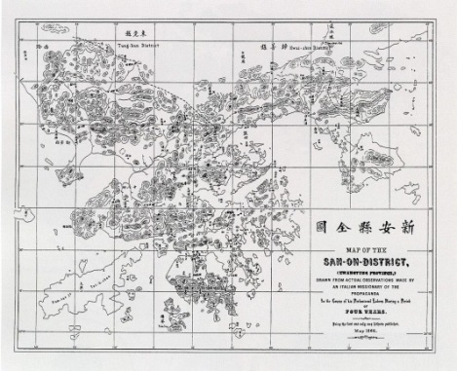
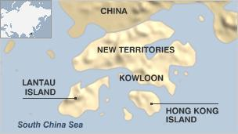
Hong Kong
Part of the District of Sam on during the Qing Dynasty
Formed by three main parts:
  Hong Kong Island (ceded to the British in 1842)
  Kowloon Peninsula (ceded to the British in 1860)
  New Territories (rented to the British for 99 years since 1898)
A Special Administrative Region (SAR) of China after 1 July 1997
  “One Country, Two Systems” – Hong Kong will remain as a market-oriented capitalist economy for 50 years
  Chief Executive of Hong Kong is not generally elected

Slide 7
Planning System in Hong Kong
Town Planning Ordinance (TPO)
  Maintained after the handover in 1997
  Comprises development strategies at the territorial level and local level
Town Planning Board
  Formed under TPO
  Principal body responsible for statutory planning
  All members are appointed
Development Bureau
Planning Department
  Executive arm of the TPB
Regional Level
National policies
Territorial Level
Territorial Development Strategies
Local engagement
Local Level
Departmental and Statutory plans
Local engagement
X TPO
X Local engagement

Slide 8
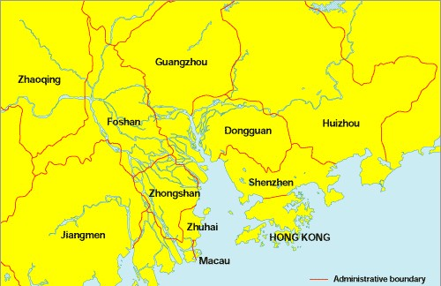
Hong Kong and China (Pre-1997 to 2003)
Very limited regional planning before 1997
  Hong Kong (British colony)
  China was politically unrest
Open Door Policy in 1978
  PRD – one of the key development areas
  Hong Kong – restructuring from an industrial centre to an international financial and service centre
Border after 1997
  Special travelling documents for both Hong Kong and Chinese residents to cross the border
  Chinese residents only allow to travel to Hong Kong on business visas or in group tours

Slide 9
Hong Kong and China (Post 2003)
Political and economic crises since 1997
Individual Visit Scheme
  To allow visitors from Mainland China to visit Hong Kong on an individual basis
Mainland and Hong Kong Closer Economic Partnership Arrangement (CEPA)
  To allow qualified products, companies and residents of Hong Kong to enjoy preferential access to the Chinese market
  The increasing economic cooperation between the two places also supported the cross-border passenger and freight traffic

Slide 10
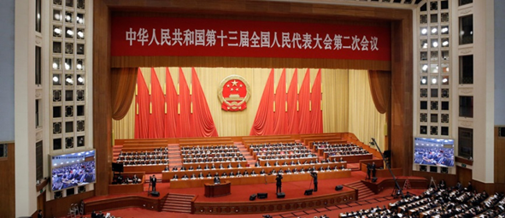
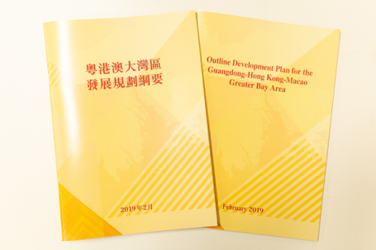
Guangdong-Hong Kong-Macao Greater Bay Area
Firstly announced under the National 13th Five-Year Plan during the 19th National Congress of the Communist Party of China
Comprises 11 major cities including Hong Kong, covering a total area of 56,000 square kilometres
Important role in the Belt and Road Initiative
One of the key strategies is to improve the infrastructural connectivity of the Area
  Guangzhou-Shenzhen-Hong Kong Express Rail Link (XRL
  Hong Kong-Zhuhai-Macao Bridge (HZMB)

Slide 11
Subject Description
Miracle or Disaster:
How Regional Planning outside the Border can influence Local Planning inside the Border?

Slide 12
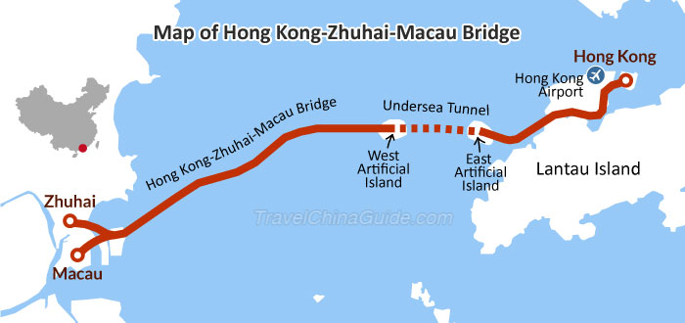
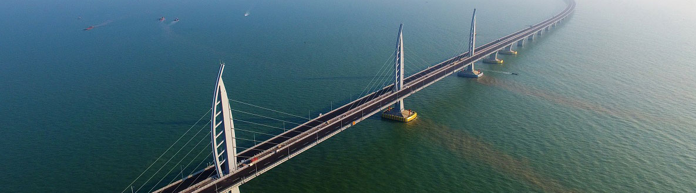
Hong Kong-Zhuhai-Macao Bridge (HZMB)
Links three major cities Hong Kong, Zhuhai and Macao, which are geographically close but separated by water.
Travelling time between Zhuhai and Hong Kong on the road
  240 minutes → 30 minutes
Creating “Bridgehead Economy”
Enhancing the connectivity of the western part of the PRD

Slide 13
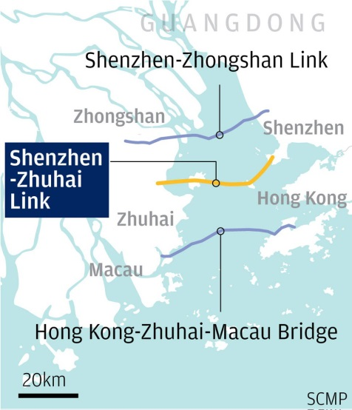
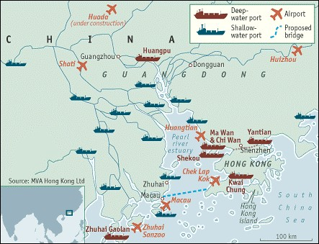
Hong Kong-Zhuhai-Macao Bridge (HZMB)
Delay due to a legal challenge regarding the environmental impact of the HZMB
Doubts on the official projections and estimated volume of traffic
  Alternative ports and links within the PRD
High cost (15 Billion GBP)
Causing environmental issues
Complexity of the HZMB permit
  Insurance policies
  Prohibited to enter the urban area in Macao
  A separate special car registration permit is required to enter three cities

Slide 14
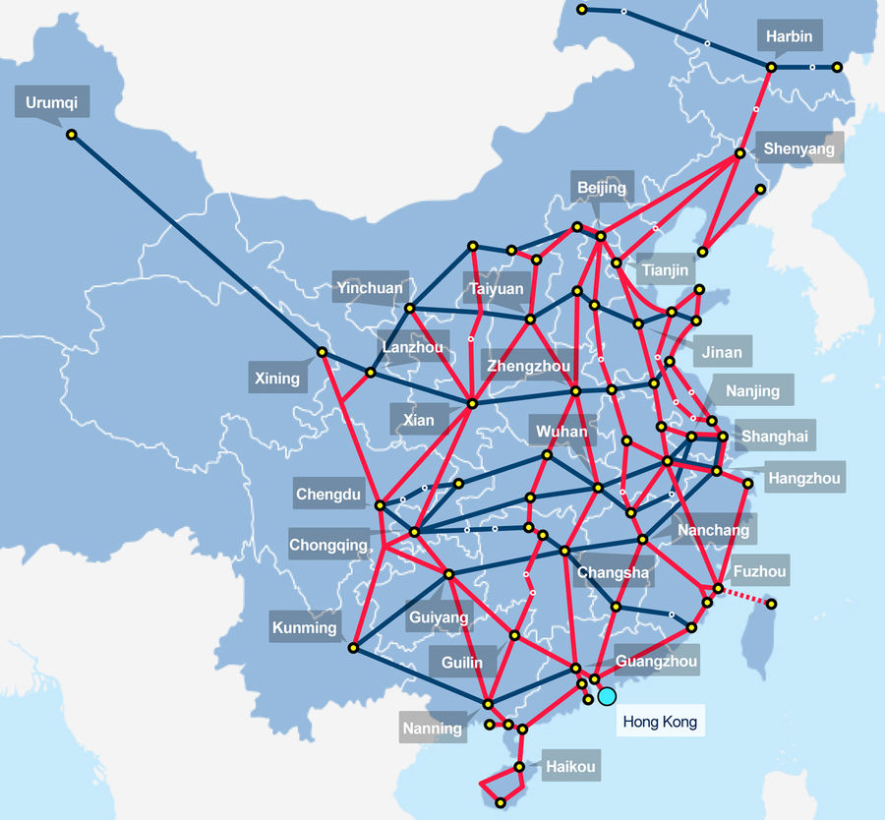
Guangzhou-Shenzhen-Hong Kong Express Rail Link (XRL)
Part of the proposed 12,000 kilometres of “four vertical and four horizontal” passengers lines of the Chinese national high-speed railway network
The Scheme was firstly gazetted in 2008
Approved by the pro-establishment lawmakers who form a majority in the Legislative Council of Hong Kong in 2010

Slide 15

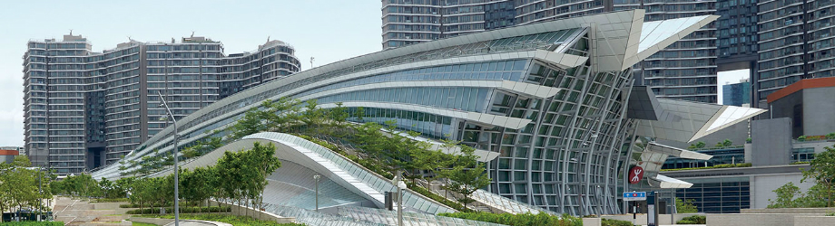
Guangzhou-Shenzhen-Hong Kong Express Rail Link (XRL)
High cost of the XRL (8.9Billion GBP)
Requires land resumption of Choi Yuen Village with about 500 villagers
  No meetings or discussion were arranged
  A warning note was received to vacate the village by November 2010
  Leads to a large scale anti-XRL social movement
Doubts on the official projections and estimated returns

Slide 16
Analysis
Miracle or Disaster:
How Regional Planning outside the Border can influence Local Planning inside the Border?

Slide 17
Pro-National or Regional Planning
Economic-minded planning dilemma
  Economically dependent to Chinese economy and tourists
  National and regional planning policies and economic development always prioritise first
Lack of local engagement
  Appointed TPB Members
  Limited responsibilities to address the local planning issues and concerns
  No stacks in formulating regional planning policies

Slide 18
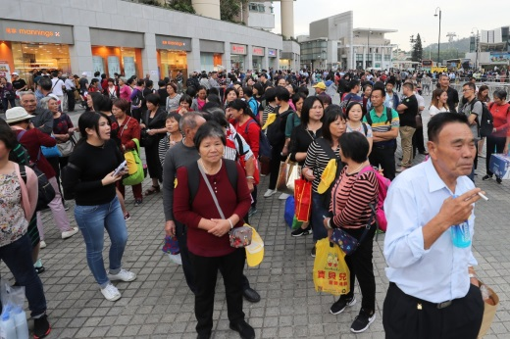
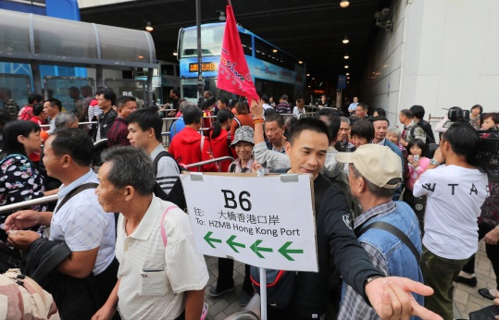
Hong Kong-Zhuhai-Macao Bridge (HZMB)
Nationally-supported
Overemphasis on “Bridgehead economy”
Considered as a “White Elephant Project”
Impacts on local communities and environment

Slide 19
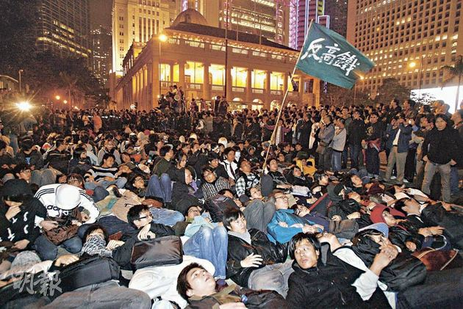
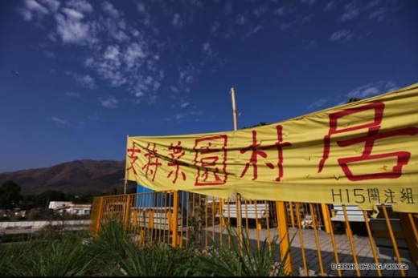
Guangzhou-Shenzhen-Hong Kong Express Rail Link (XRL)
Nationally-supported
Considered as another “White Elephant Project”
Local communities - No stacks in the development
Leading to a social anti-XRL movement

Slide 20
Way Forward
Miracle or Disaster:
How Regional Planning outside the Border can influence Local Planning inside the Border?

Slide 21
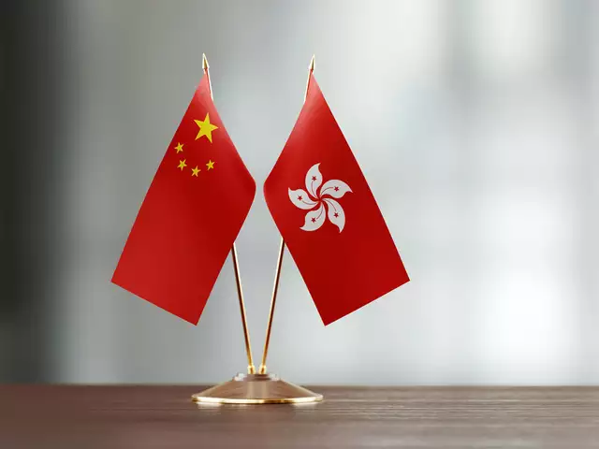

Way Forward
Sustainable Development > Economic-minded planning dilemma
Important role of local governments / planning authorities
  Identifying the local needs in regional planning at the earliest opportunity
Local engagement
  Formulating regional planning policies
  Proactive role in the planning system

Slide 22
Miracle or Disaster:
How Regional Planning outside the Border can influence Local Planning inside the Border?
Vivian Ko & Jeffrey Ng
12 September 2019
13th European biennial of towns and town planners 2019 | planning on the edge

